Slide 1



HELLO EVERYONE

Slide 2

Cloud computing

Slide 3
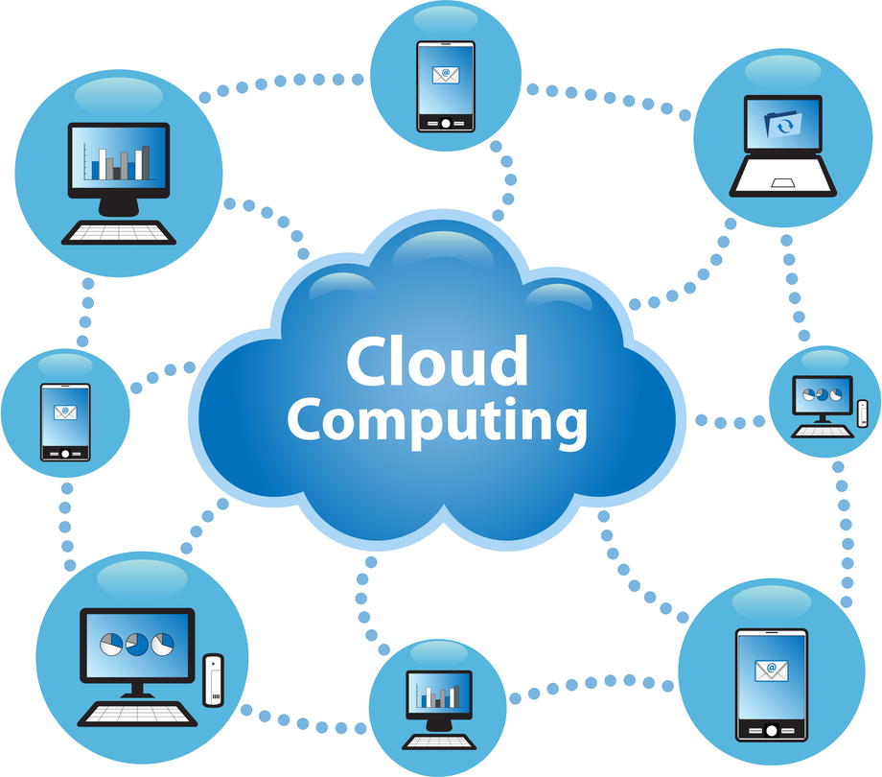
What is cloud computing?
Cloud computing is the delivery of computing services such as servers, storage, databases, networking, software, and analytics over the internet instead of relying on local hardware. It provides flexibility, scalability, and cost-efficiency, as users can scale their usage up or down based on needs.

Slide 4

Public Cloud:
Description: Resources like servers and storage are owned and operated by third-party providers and shared among multiple organizations over the internet.
Examples: Amazon Web Services (AWS), Microsoft Azure, Google Cloud Platform.
Benefits: Scalability, cost-effectiveness, and minimal maintenance.
Considerations: Potential security and compliance concerns due to shared infrastructure.
Private Cloud:
Description: Dedicated infrastructure exclusively for a single organization, either managed internally or by a third-party, hosted on-premises or off-site.
Examples: VMware vSphere, Microsoft Azure Stack(Private Cloud).
Benefits: Enhanced security, greater control, and customization.
Considerations: Higher costs and maintenance responsibilities.
Hybrid Cloud:
Description: A combination of public and private clouds, allowing data and applications to be shared between them.
Examples: AWS Outposts (Hybrid with Public Cloud Integration), Microsoft Azure Stack (Hybrid Cloud).
Benefits: Flexibility, optimized workload distribution, and cost efficiency.
Considerations: Complexity in management and potential security challenges.
Types of cloud computing

Slide 5


Community Cloud:
Description: Community cloud is a cloud infrastructure that allows systems and services to be accessible by a group of several organizations to share the information. It is owned, managed, and operated by one or more organizations in the community, a third party, or a combination of them.
Examples: Our government organization within Nepal may share computing infrastructure in the cloud to manage data.
Benefits: Scalability and flexibility, cost-effectiveness, and security.
Considerations: Limited to specific groups and complexity in management.
This Photo by Unknown Author is licensed under CC BY-SA-NC

Slide 6
Feature | Public Cloud | Private Cloud | Hybrid Cloud | Community Cloud
Ownership | Owned by third-party providers | Owned by one organization | Combination of public and private | Shared among multiple organizations with common interests
Resource Sharing | Shared among many tenants | Dedicated to one organization | Can share resources between both environments | Shared among a specific group of organizations
Control | Limited control over infrastructure | Full control over infrastructure and security | Control over both public and private resources | Shared control among community members
Scalability | Highly scalable and flexible | Limited scalability based on resources | Flexible, with the ability to scale across both environments | Scalable within the community's shared infrastructure
Cost | Pay-as-you-go, low upfront costs | High upfront and ongoing maintenance costs | Can be more cost-effective depending on usage | Costs are shared among community members
Security & Compliance | Lower (shared resources) | High (dedicated resources) | Varies, but typically offers strong security with flexibility | High (designed to meet specific security or regulatory needs of the community)
Ideal For | Startups, small businesses, or low-cost applications | Enterprises with sensitive data or regulatory requirements | Organizations that need flexibility and want to optimize cost and security | Organizations with shared regulatory, security, or industry-specific needs

Slide 7
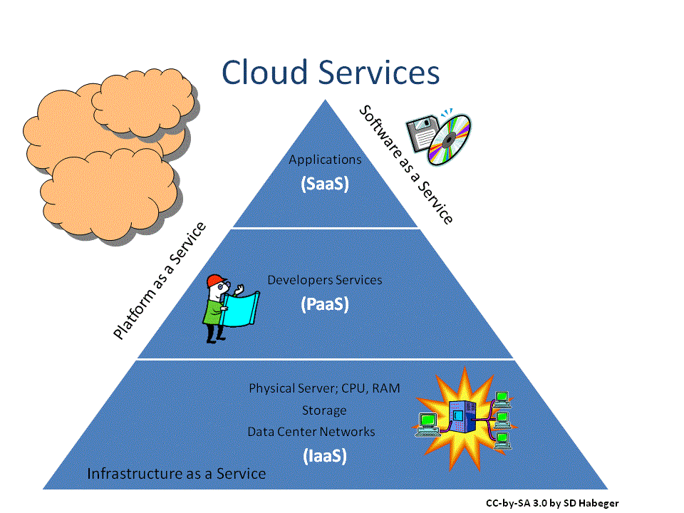
Cloud computing service models

Slide 8
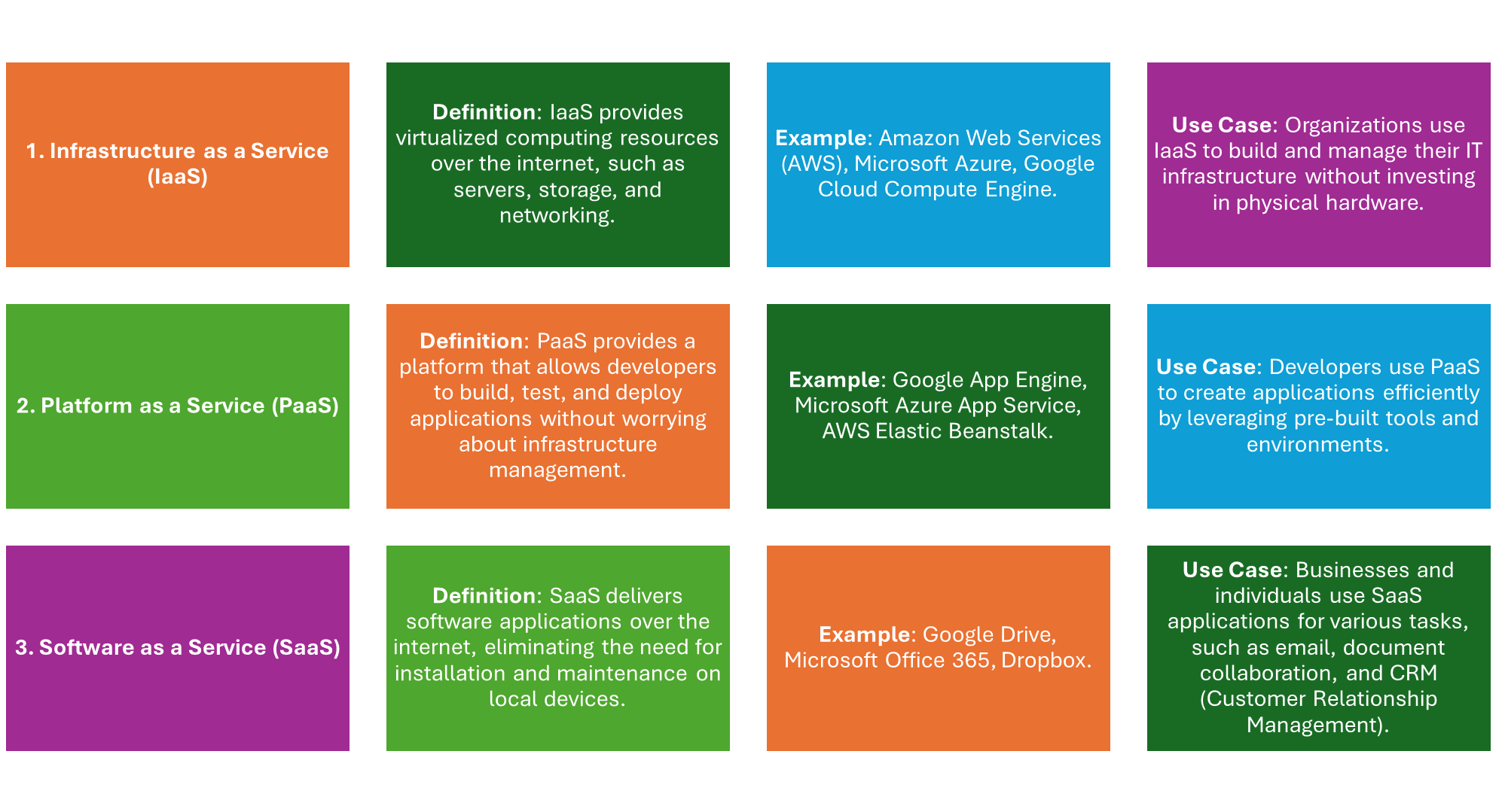

Slide 9
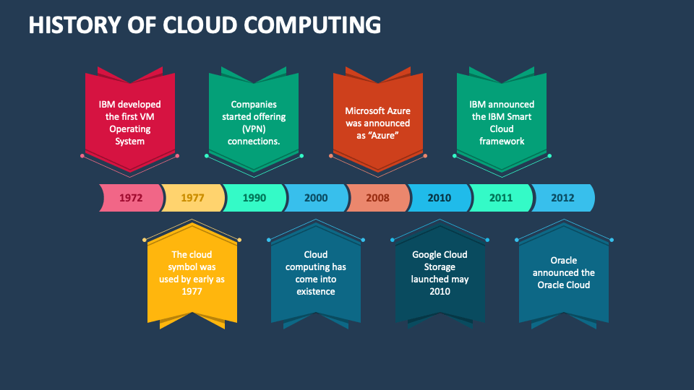

Slide 10


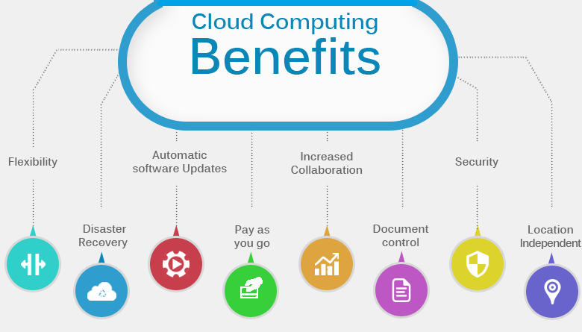
Benefits of cloud computing
Cost Efficiency:
By leveraging cloud services, businesses can reduce or eliminate the need for significant upfront investments in hardware and minimize ongoing maintenance costs. Instead, they pay for the resources they use, leading to optimized spending.
Scalability and Flexibility:
Cloud platforms provide the ability to quickly scale resources up or down in response to fluctuating demand, ensuring optimal performance without the necessity for overprovisioning.
Accessibility and Collaboration:
With cloud computing, data and applications are accessible from anywhere with an internet connection, facilitating remote work and enhancing collaboration among teams across different locations.
Automatic Updates and Maintenance:
Cloud service providers handle routine software updates and security patches automatically, ensuring users have access to the latest features and protections without manual intervention.
Enhanced Security:
Leading cloud providers invest heavily in advanced security measures to protect data and applications, often surpassing the capabilities of individual organizations. Features such as data encryption, identity management, and regular security audits help safeguard sensitive information.

Slide 11

Challenges of cloud computing
Data Security and Privacy:
Description: Storing sensitive data in the cloud raises concerns about unauthorized access, data breaches, and compliance with privacy regulations.
Mitigation: Implement robust encryption, access controls, and regularly audit security measures to protect data integrity.
Compliance and Legal Issues:
Description: Organizations must adhere to industry-specific regulations and navigate legal complexities, such as data residency requirements and cross-border data transfer laws.
Mitigation: Engage with legal experts to ensure cloud services comply with relevant regulations and contractual obligations.
Cost Management:
Description: While cloud services can be cost-effective, without proper oversight, expenses can escalate due to factors like unused resources or unexpected usage spikes.
Mitigation: Regularly monitor resource utilization, implement budgeting tools, and optimize workloads to manage costs effectively.
Vendor Lock-In:
Description: Dependence on a single cloud provider can make it challenging to migrate to alternative platforms, potentially leading to increased costs or limited flexibility.
Mitigation: Design applications with portability in mind and consider multi-cloud strategies to avoid over-reliance on one provider.
Performance and Downtime:
Description: Cloud service outages or latency issues can disrupt business operations and affect user experience.
Mitigation: Choose providers with strong uptime guarantees, implement redundancy strategies, and monitor performance continuously.

Slide 12
Future of cloud computing
Multi-Cloud and Hybrid Cloud Strategies:
Organizations are increasingly adopting multi-cloud and hybrid cloud approaches to optimize performance, enhance resilience, and avoid vendor lock-in. This strategy allows businesses to leverage the strengths of various cloud providers and seamlessly integrate on-premises infrastructure with cloud services.
Integration of Artificial Intelligence and Machine Learning:
The fusion of AI and ML with cloud platforms is enabling advanced data analytics, automation, and personalized user experiences. Cloud providers are offering AI-powered services that facilitate the development and deployment of intelligent applications across industries.
Edge Computing Expansion:
To meet the demands for low-latency processing and real-time data analysis, edge computing is gaining traction. By processing data closer to its source, edge computing reduces latency and bandwidth usage, benefiting applications like IoT devices and autonomous systems.
Serverless Computing Growth:
Serverless architectures are becoming more prevalent, allowing developers to focus on code execution without managing underlying infrastructure. This model offers scalability.

Slide 13
